Slide 1

Creating a simple node.js
application
22H51A05A5 Masini Prabhas
CSE-D

Slide 2


Introduction to Node.js
Node.js is a JavaScript runtime environment that allows you to build fast and scalable network applications. It's become popular for backend development, especially for APIs and real-time applications.

Slide 3

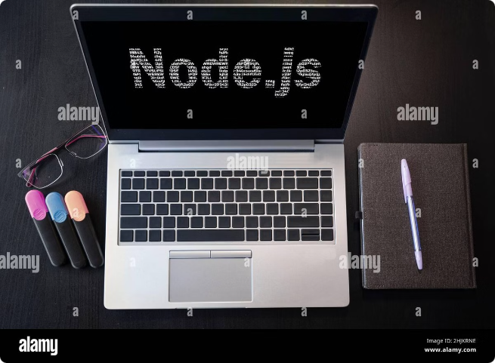
Setting up a Node.js development environment
1
Install Node.js
Download the appropriate installer for your operating system from the Node.js website and follow the installation instructions.
2
Install a code editor
Popular choices include Visual Studio Code, Atom, and Sublime Text. These editors provide syntax highlighting, debugging tools, and other helpful features.
3
Set up a project
Create a new directory for your Node.js project and use the `npm init` command to create a `package.json` file, which manages project dependencies.

Slide 4

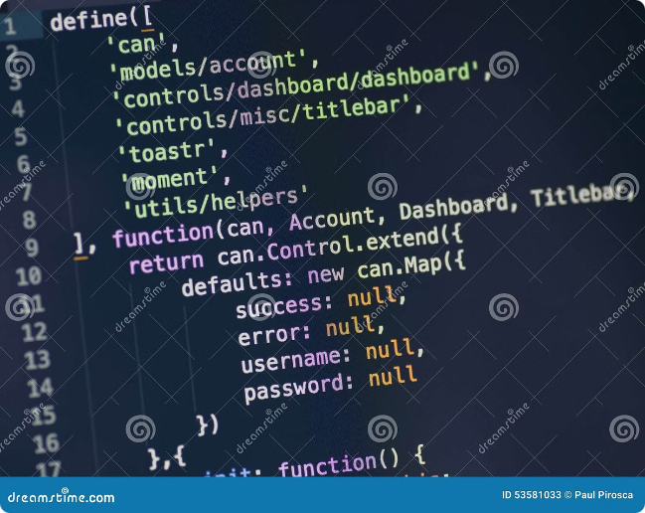
Creating a basic Node.js application
Create a script file
Import the `http` module
Create a file named `app.js` or similar. This file will contain the logic for your application.
Use the `require()` function to access the built-in `http` module, which provides functions for handling HTTP requests.
Create a server
Start the server
Use the `createServer()` function to create an HTTP server object. This object listens for incoming requests and responds accordingly.
Call the `listen()` method on the server object, specifying the port to listen on. This will start the server and make it available to receive requests.

Slide 5


Handling HTTP requests and responses
1
Request Object
2
Response Object
The `request` object contains information about the incoming HTTP request, such as the method (GET, POST, etc.), URL, headers, and body.
The `response` object is used to send a response back to the client. You can set the status code, headers, and body of the response.
3
Routing
4
Data Handling
You can use routing mechanisms to handle different requests based on the URL. Popular routing libraries include Express.js and Koa.
You can use modules like `JSON` or `URL` to parse and format data for both request and response bodies.

Slide 6





Deploying your Node.js application
Choose a hosting platform
Popular choices include Heroku, AWS, and DigitalOcean.
Configure deployment settings
Set up your project to work with the chosen hosting platform, including database connections and environment variables.
Deploy your application
Follow the deployment instructions provided by the hosting platform to push your code to the server.

Slide 7
THANK YOU

